Slide 1
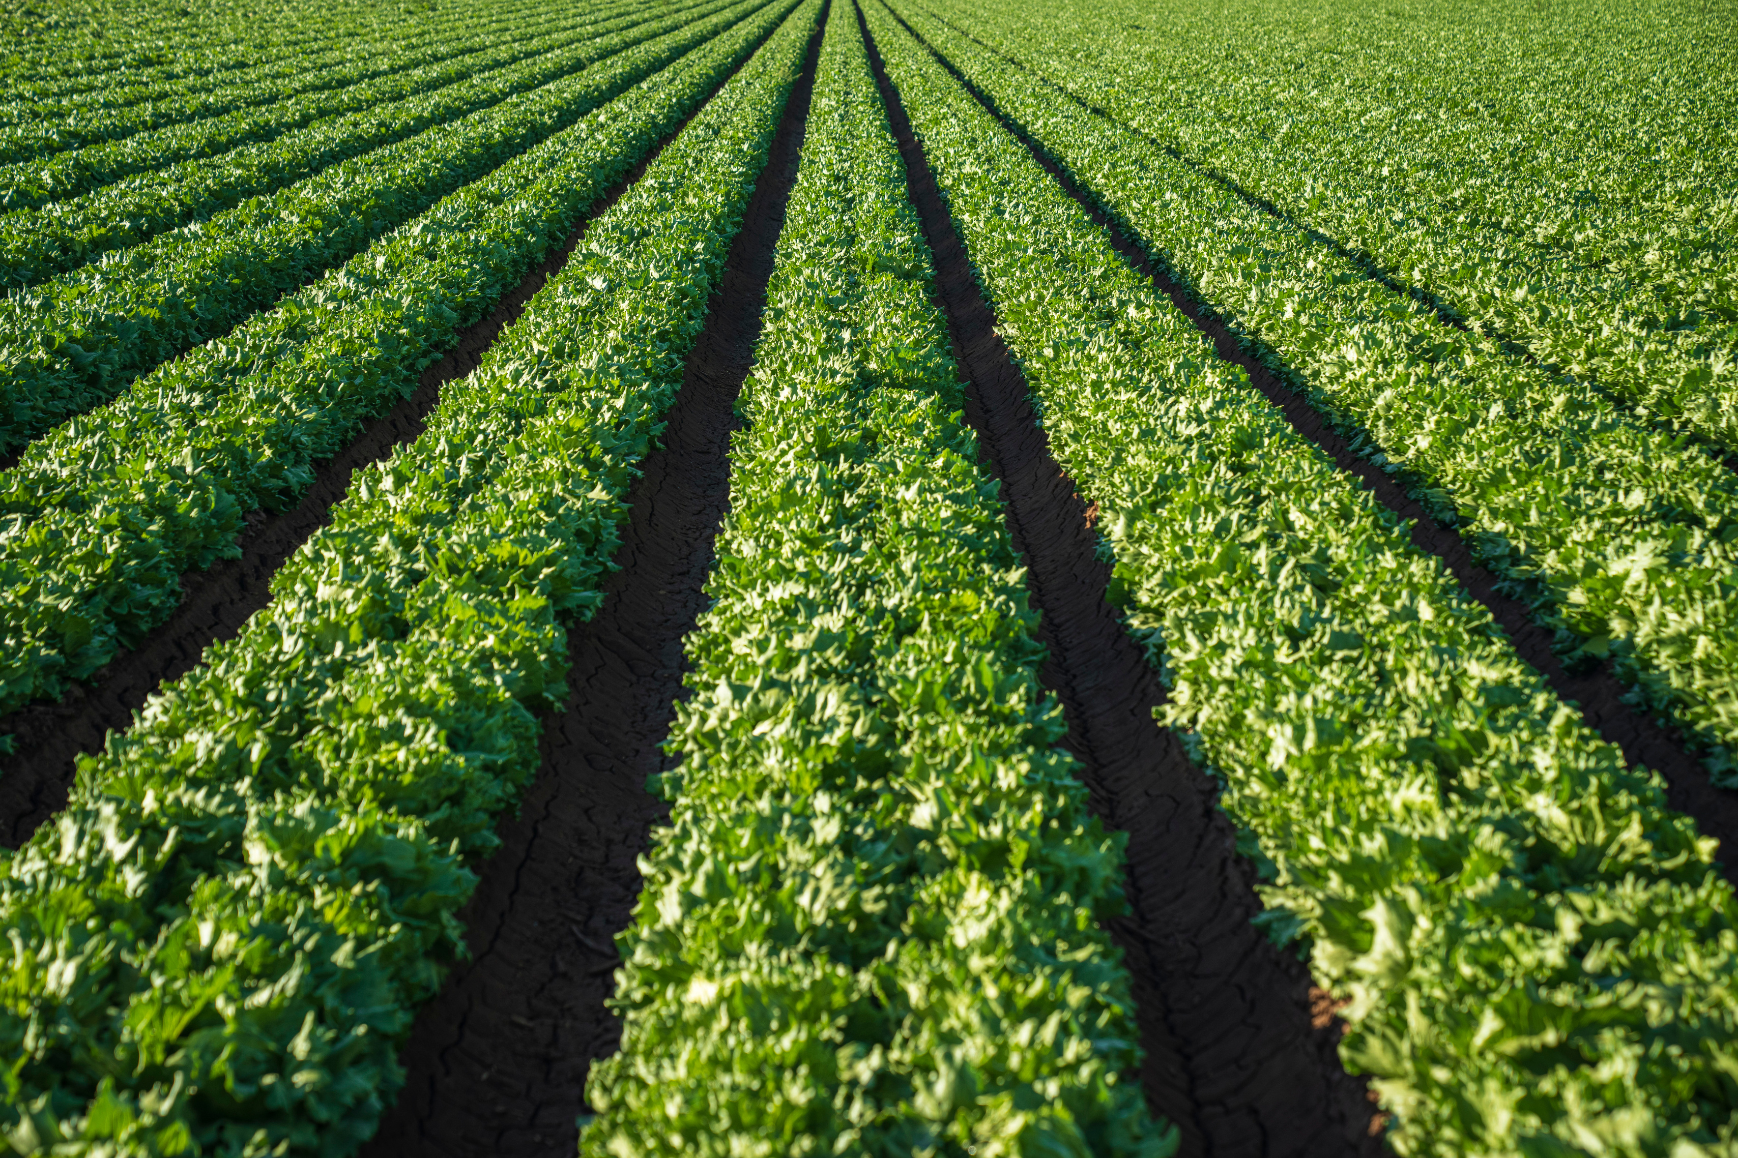
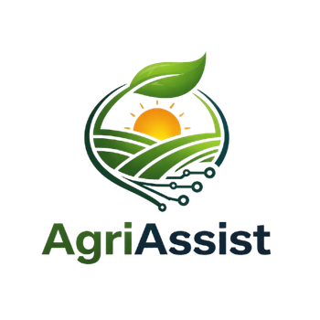
AGRI ASSIST
AI Based Crop Disease Detection and Crop Recommendation
M Sai Pallavi
BG Sreevani
R Govardhan Sai Ganesh
2303A54063
2303A54066
2303A54044
Team
Members

Slide 2
Introduction
Agriculture is a crucial sector that supports the livelihood of millions, but farmers often face challenges such as crop diseases, unpredictable weather, and lack of proper market information. These issues can reduce productivity and increase financial risks.
AgriAssist – AI Farming Assistant is an intelligent system designed to help farmers make better decisions using Artificial Intelligence and Data Science. It provides features like crop disease detection, crop recommendation, weather updates, and market insights.
The main aim of AgriAssist is to combine modern technology with traditional farming practices to improve crop yield, reduce risks, and support sustainable agriculture.

Slide 3
Objective
To develop an AI-based system that assists farmers in making informed agricultural decisions.
To detect crop diseases using image processing and machine learning techniques.
To recommend suitable crops based on soil type, weather, and environmental conditions.
To provide real-time weather updates to help in planning farming activities.
To analyze and predict market prices for better selling decisions.
To create a user-friendly platform accessible to farmers with minimal technical knowledge.
To promote efficient, sustainable, and technology-driven farming practices.

Slide 4
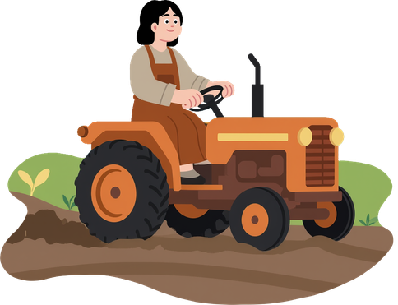



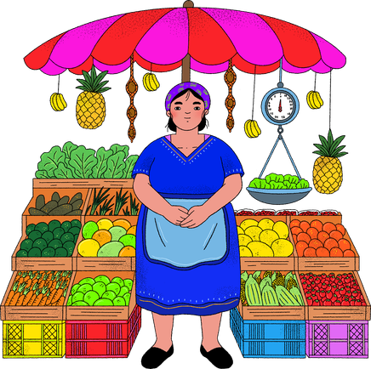
Stakeholders
FARMERS
Agricultural Experts
Government Agencies
Primary users who benefit from crop recommendations, disease detection, and market insights.
Provide knowledge, validation, and guidance for accurate recommendations.
Support implementation through agricultural policies and digital initiatives.
Researchers & Developers
Researchers & Developers
Market Vendors/Buyers:
Use insights for supply chain, fertilizers, and seed distribution.
Design, improve, and maintain the AI models and system.
Benefit from better price predictions and crop availability information.

Slide 5
Programming Languages, Tools, and Software
Programming Languages:
Python (for machine learning and backend development)
JavaScript (for frontend development)
HTML & CSS (for designing user interface)
Tools & Software:
VS Code (code editor)
Jupyter Notebook (model training and testing)
Git & GitHub (version control)
Postman (API testing)
Frameworks & Libraries:
React.js (frontend development)
Flask (backend development)
TensorFlow / Keras (for building ML models)
Scikit-learn (for data analysis and prediction)
Database:
MongoDB / Firebase (for storing user and application data)
APIs & Services:
Weather API (for real-time weather updates)
Market Data API (for crop price information)

Slide 6
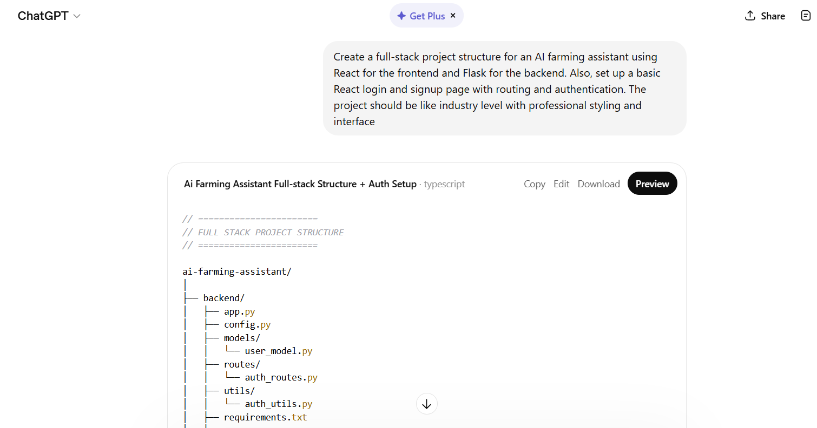
Complete Code Generation Prompts
Prompt 1
Create a full-stack project structure for an AI farming assistant using React for the frontend and Flask for the backend. Also, set up a basic React login and signup page with routing and authentication. The project should be like industry level with professional styling and interface

Slide 7
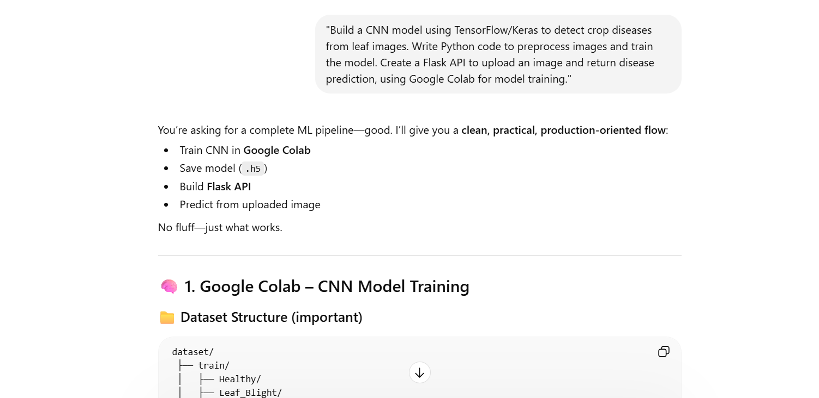
Prompt 2
"Build a CNN model using TensorFlow/Keras to detect crop diseases from leaf images. Write Python code to preprocess images and train the model. Create a Flask API to upload an image and return disease prediction, using Google Colab for model training."

Slide 8
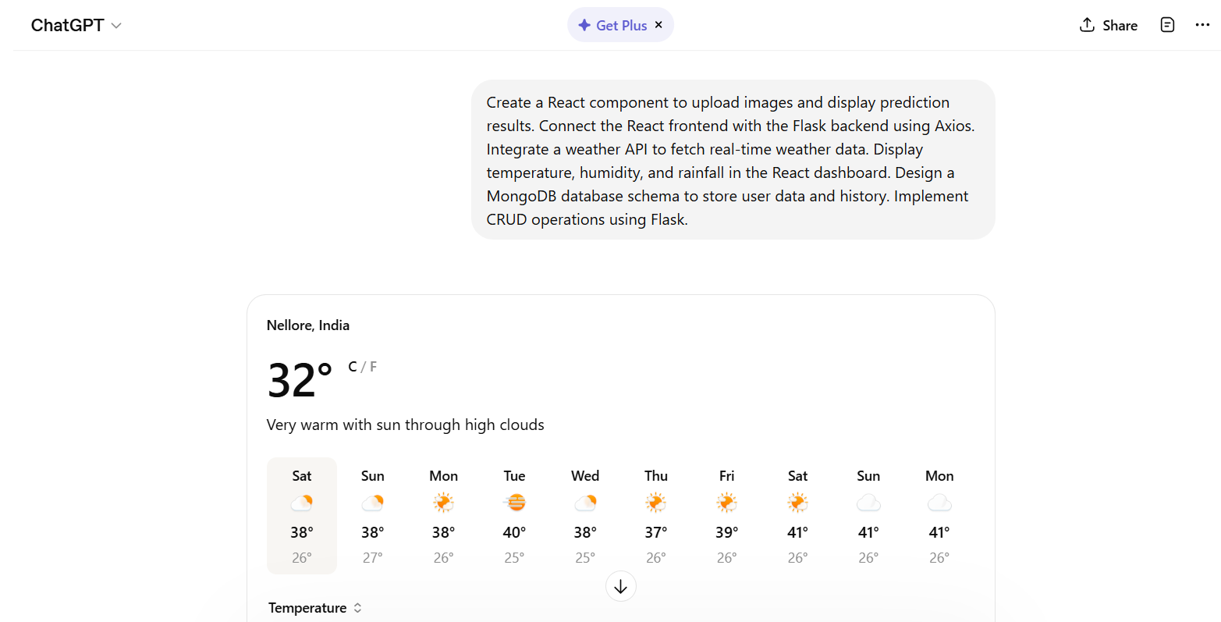
Prompt 3
Create a React component to upload images and display prediction results. Connect the React frontend with the Flask backend using Axios. Integrate a weather API to fetch real-time weather data. Display temperature, humidity, and rainfall in the React dashboard. Design a MongoDB database schema to store user data and history. Implement CRUD operations using Flask.

Slide 9
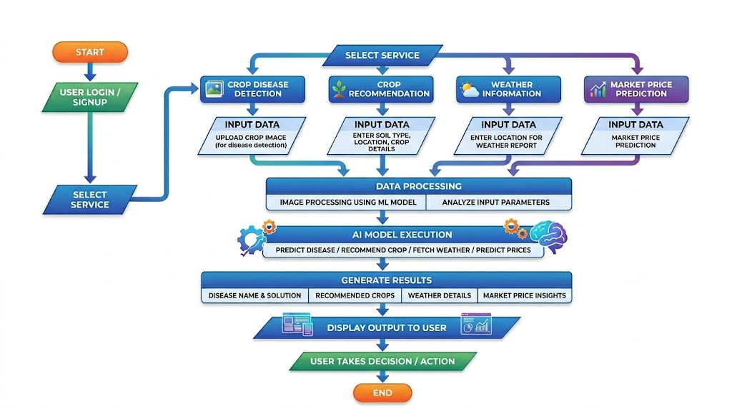
Flowchart of the Workflow

Slide 10

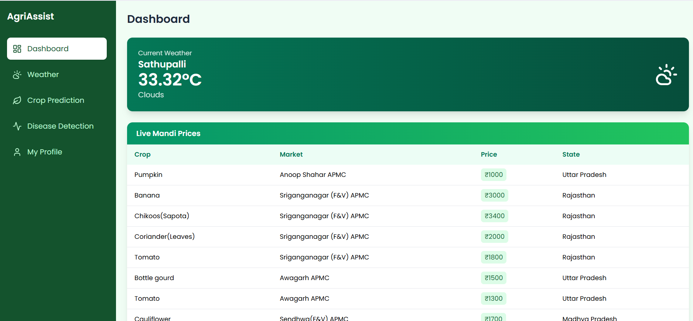
Front-end view web application

Slide 11

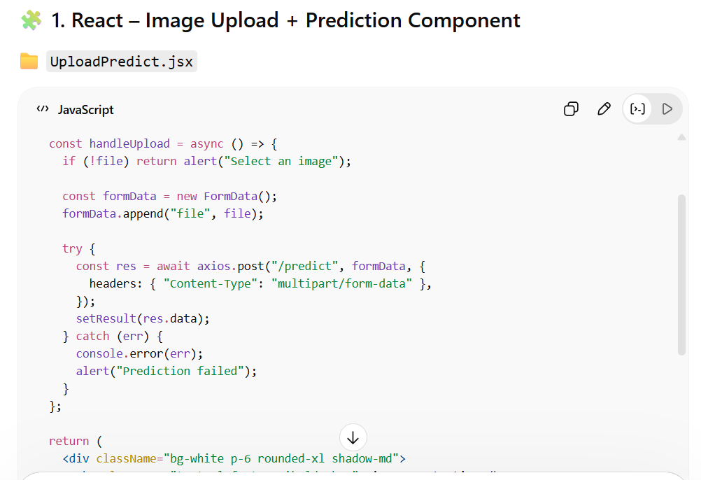
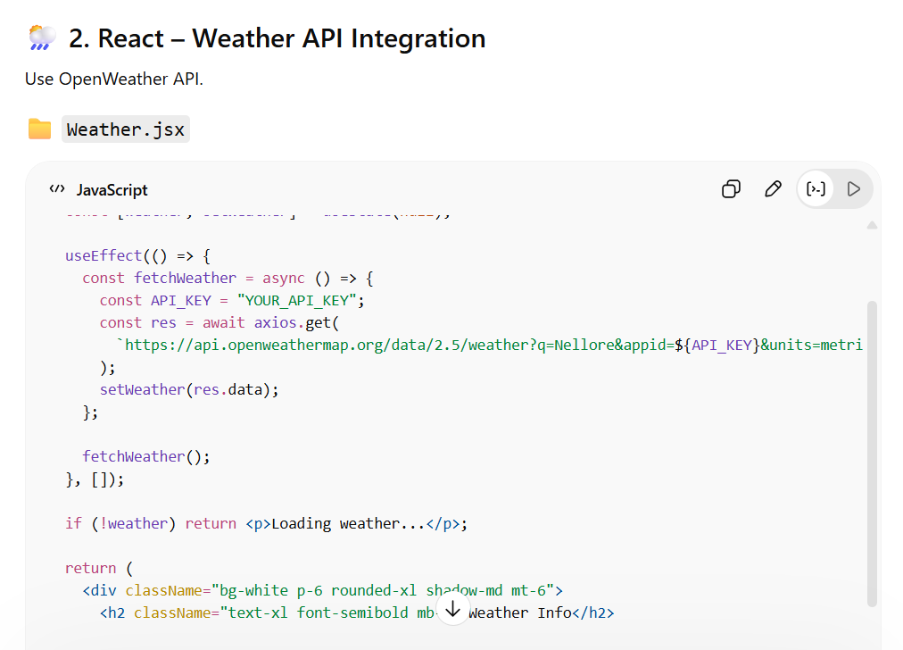
Proof of Prompts generating codes

Slide 12


References
Research papers on crop disease detection using CNN: https://ieeexplore.ieee.org/document/8579082
Agricultural datasets from Kaggle: https://www.kaggle.com/datasets/emmarex/plantdisease
Software Application / Website URL:
https://agri-assist-backend-0owy.onrender.com
Codes
Machine Learning Model Code (Python – TensorFlow/Keras)
Backend API Code (Flask – Python)
Frontend Code (React.js – JavaScript)
Database Integration Code (MongoDB/Firebase)
(All source code is maintained in the GitHub repository for easy access and version control)
AI Tools Used
ChatGPT (for code generation, debugging, and guidance)
GitHub Copilot (for code suggestions)
Google Colab (for model training and experimentation)
TensorFlow/Keras (for building AI models)
Scikit-learn (for data analysis and prediction)

Slide 13
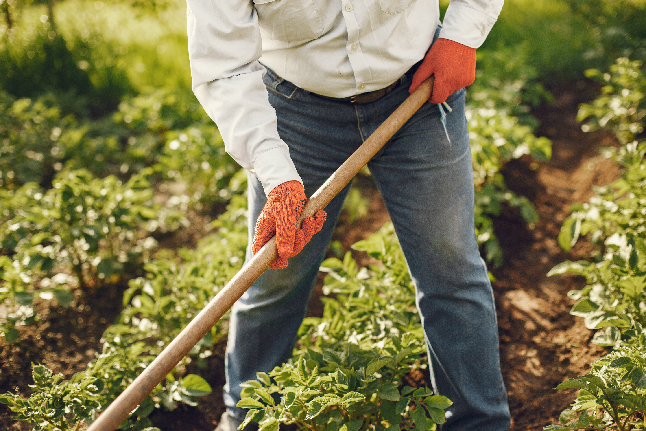
THANK YOU

